Slide 1
Alcon Week of 2/5 Updates

Slide 2
Status of Items
Stage Controller – Received
Z-axis design – In Development, Yolanda, Brian, Matthew
Stage Controller Design – Drafting sketch for design based on received stage controller (Ongoing Documents\Hardware Documentation), Yolanda, Brian
Python and OpenCV – Want to continue researching to complete code after stage controller design, Landon, Isaac, Tandol
Particulate Optics – Polarizing filters ordered, Brian, Landon

Slide 3
Future Goals:
FMEA – Continue Developing, adding to list of modes, Everyone
Pugh Matrix, Hardware – in Progress, Everyone
Pugh Matrix, Software – In Progress, Everyone
Portfolio of Project Progress – Ongoing, Everyone

Slide 4
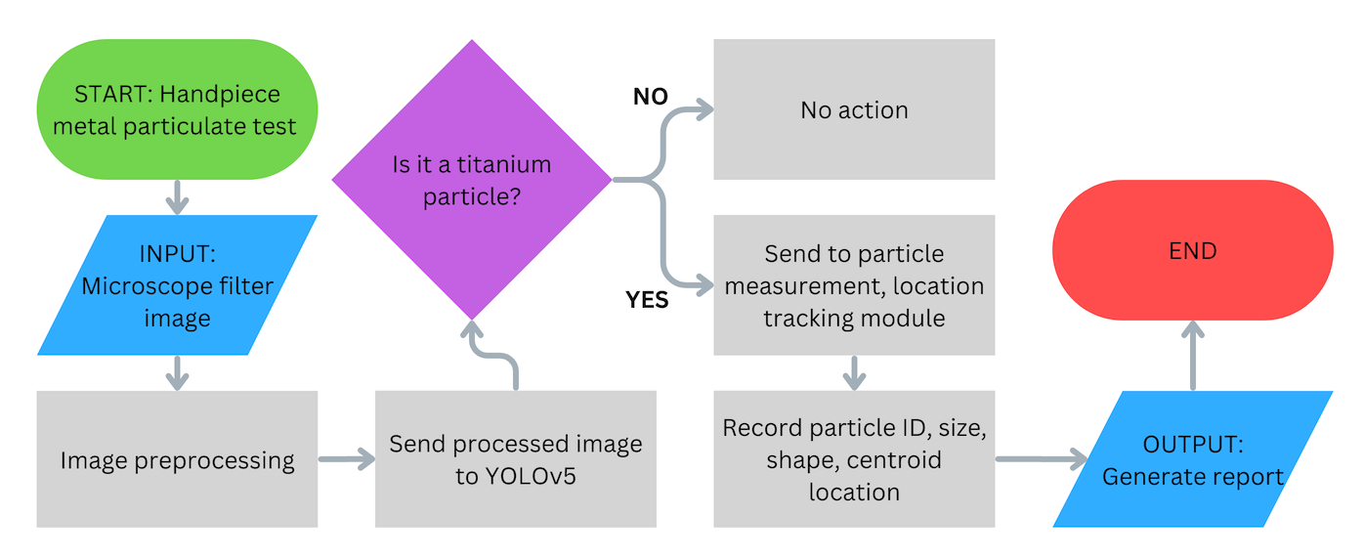
Software flowchart

